Slide 1
Pseudo-Element Selectors

Slide 2
Agenda
Pseudo-Element Selectors
Sample output
Pseudo-Element Selectors implementation

Slide 3
Pseudo-Element Selectors
Use to style a particular element in the html tag.
Syntax:
Selector::element selector{
Property: value;
}
Example:
#pseudo-element-style::first-line{
color: rgb(61, 233, 99);
}

Slide 4
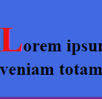


Pseudo-Element Selectors
All Pseudo elements
::after
p::after {content: “...”} -this will concat content(...) after every p tag
::before
p::before{content: “:) ”} -this will concat content[ :) ] before every p tag
::first-letter
p::first-letter{font-size: 20px} -this will style first letter of every p tag
p::after
2. p::before
3. p::first-letter

Slide 5
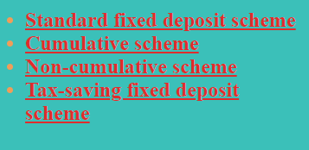
Pseudo-Element Selectors
4. ::first-line
p::first-line{color: green} -colors first line only
5. ::marker
::marker{font-weight: bold} -bolds the markers
(bullet point, numbering, etc.,)

Slide 6
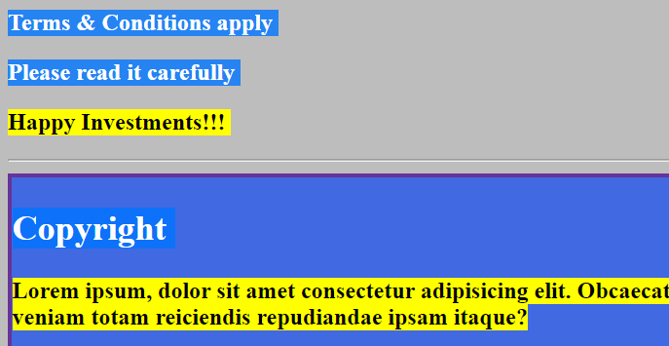
Pseudo-Element Selectors
6. ::selection
p::selection{background-color: yellow} -highlights selected text of every p tag by user.
::selection{background-color: yellow} -highlights everything you select on the screen.

Slide 7
Pseudo-Element Selectors implementation
Lets see the implementation of Pseudo-Element Selector.

Slide 8
Summary
Pseudo element selector is used to select a particular letter or line based on the property and style it.
DO NOT WRITE ANYTHING
HERE. LEAVE THIS SPACE FOR
WEBCAM

Slide 9
Thank You
Proprietary content. ©Great Learning. All Rights Reserved. Unauthorized use or distribution prohibited

